Slide 1
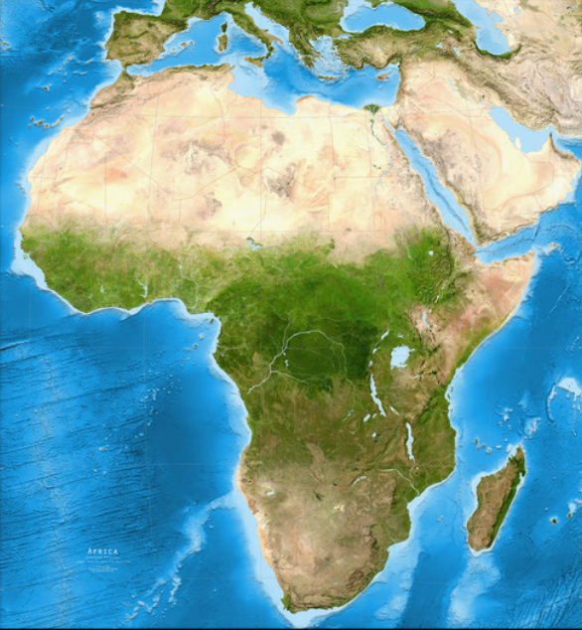

Implementing Reproductive & Fertility health guide across locations
- Africa

